Slide 1

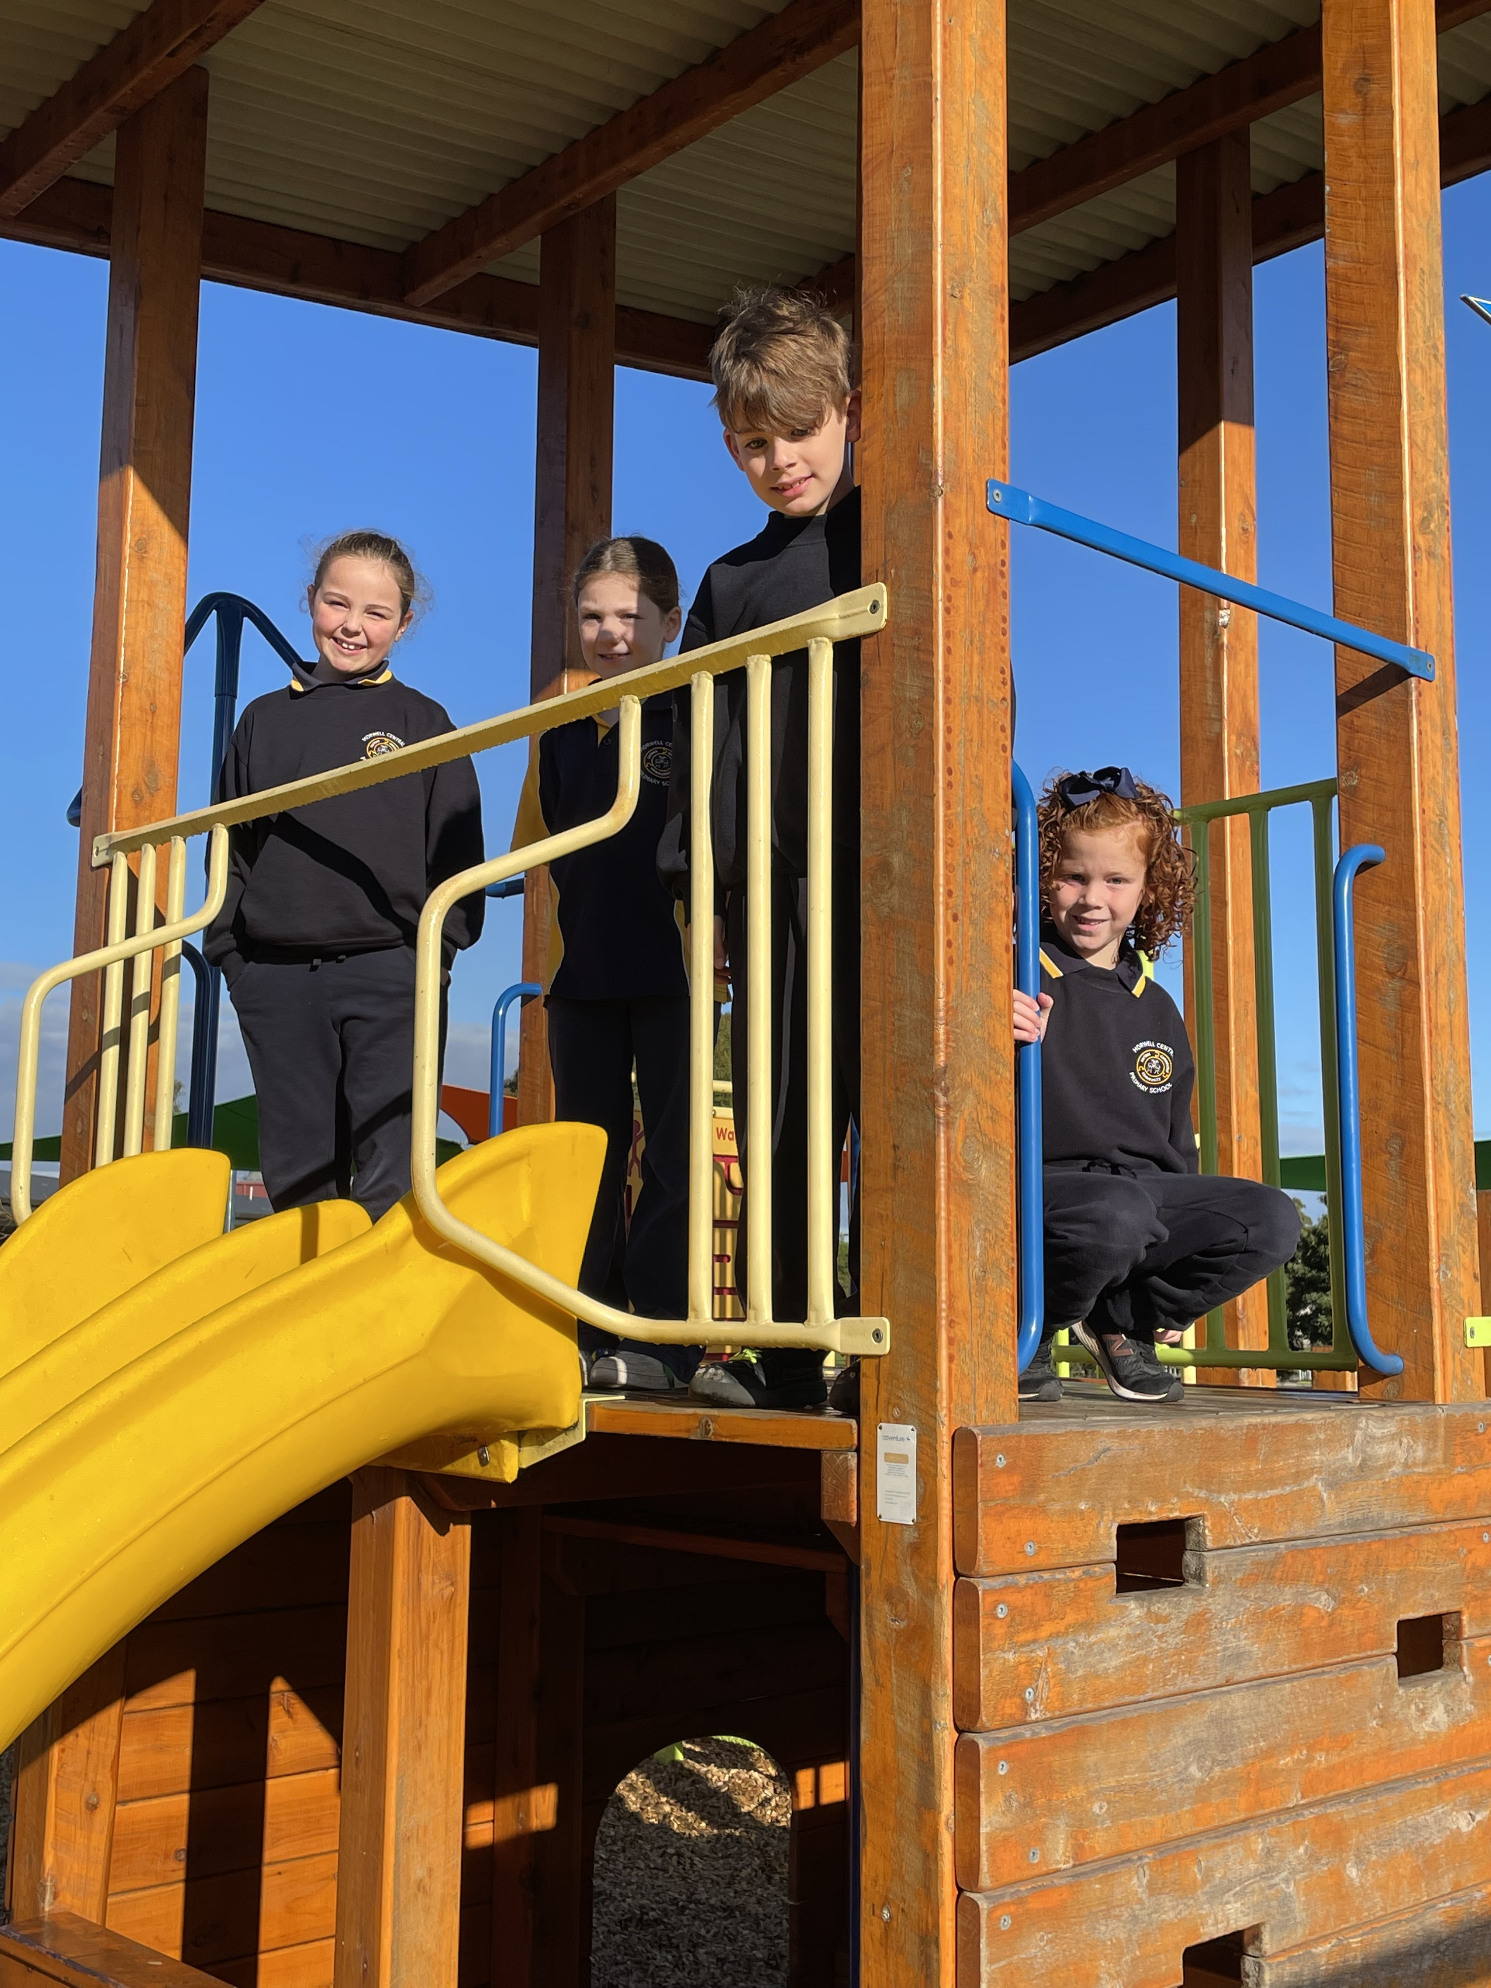

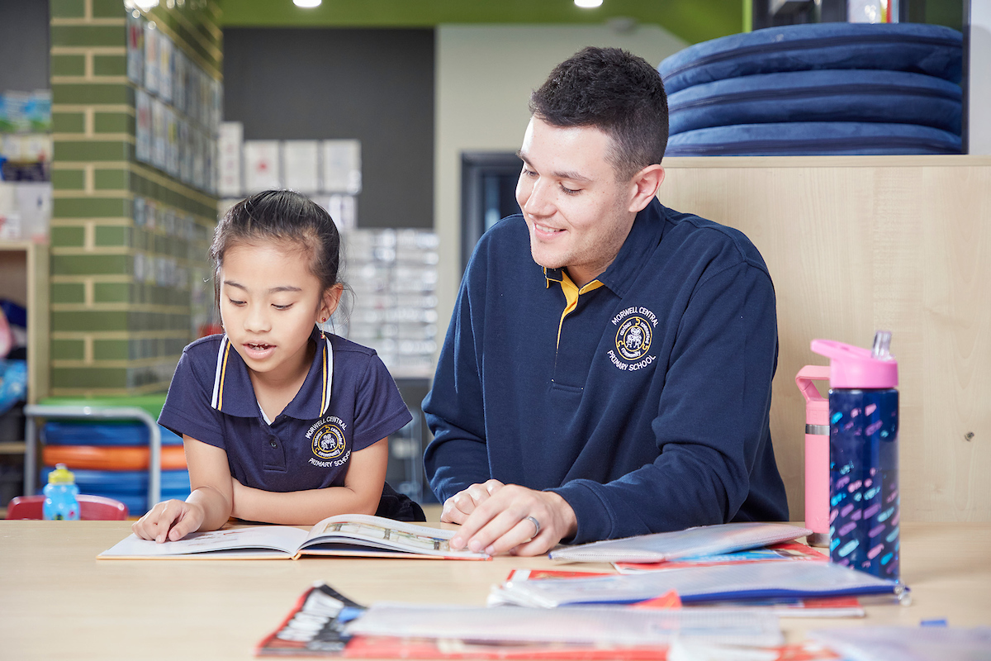
“A curious, connected learning community.”
ASPIRE
Morwell Central Primary School
Parent Handbook

Slide 2
Our Guiding Principles
Welcome to Morwell Central!
Our Teachers:
have high expectations, build positive relationships and plan thoroughly.
know where students are developmentally and scaffold their learning for all students to move forward.
Our school has high quality, dedicated staff, who strive to ensure all children reach their full learning potential. We are dedicated to upholding a core set of values, where Acceptance, Support, Persistence, Individual Responsibility, Respect and Excellence (ASPIRE) are an integral part of all interactions.
All members of the school community are committed, enthusiastic and engaged in student learning. Students, staff and parents build positive relationships using our ASPIRE values.
Our Students:
are encouraged to take ownership of their learning through setting goals, self-reflecting and self- assessing.
always strive to do their best.
The Learning Environment is:
engaging and challenging.
safe and supportive.
collaboratively owned by all.
The School Community:
supports students to be responsible citizens who are able to use a variety of thinking and learning strategies.
Our Vision
The Community of Morwell Central Primary School is committed to creating an environment that nurtures learning for life.
School Times
“A Curious, connected learning community”
8:30am – 10:30am
10:30am – 10:40am
10:40am – 11:10am
11:10am – 1:10pm
1:10pm – 1:20pm
1:20pm – 1:50pm
1:50pm – 3:00pm
… 1st Learning Block
… Eating Time Inside
… RECESS
… 2nd Learning Block
… Eating Time Inside
… LUNCH
… 3rd Learning Block
An environment that demonstrates and upholds our ASPIRE values.

Slide 3

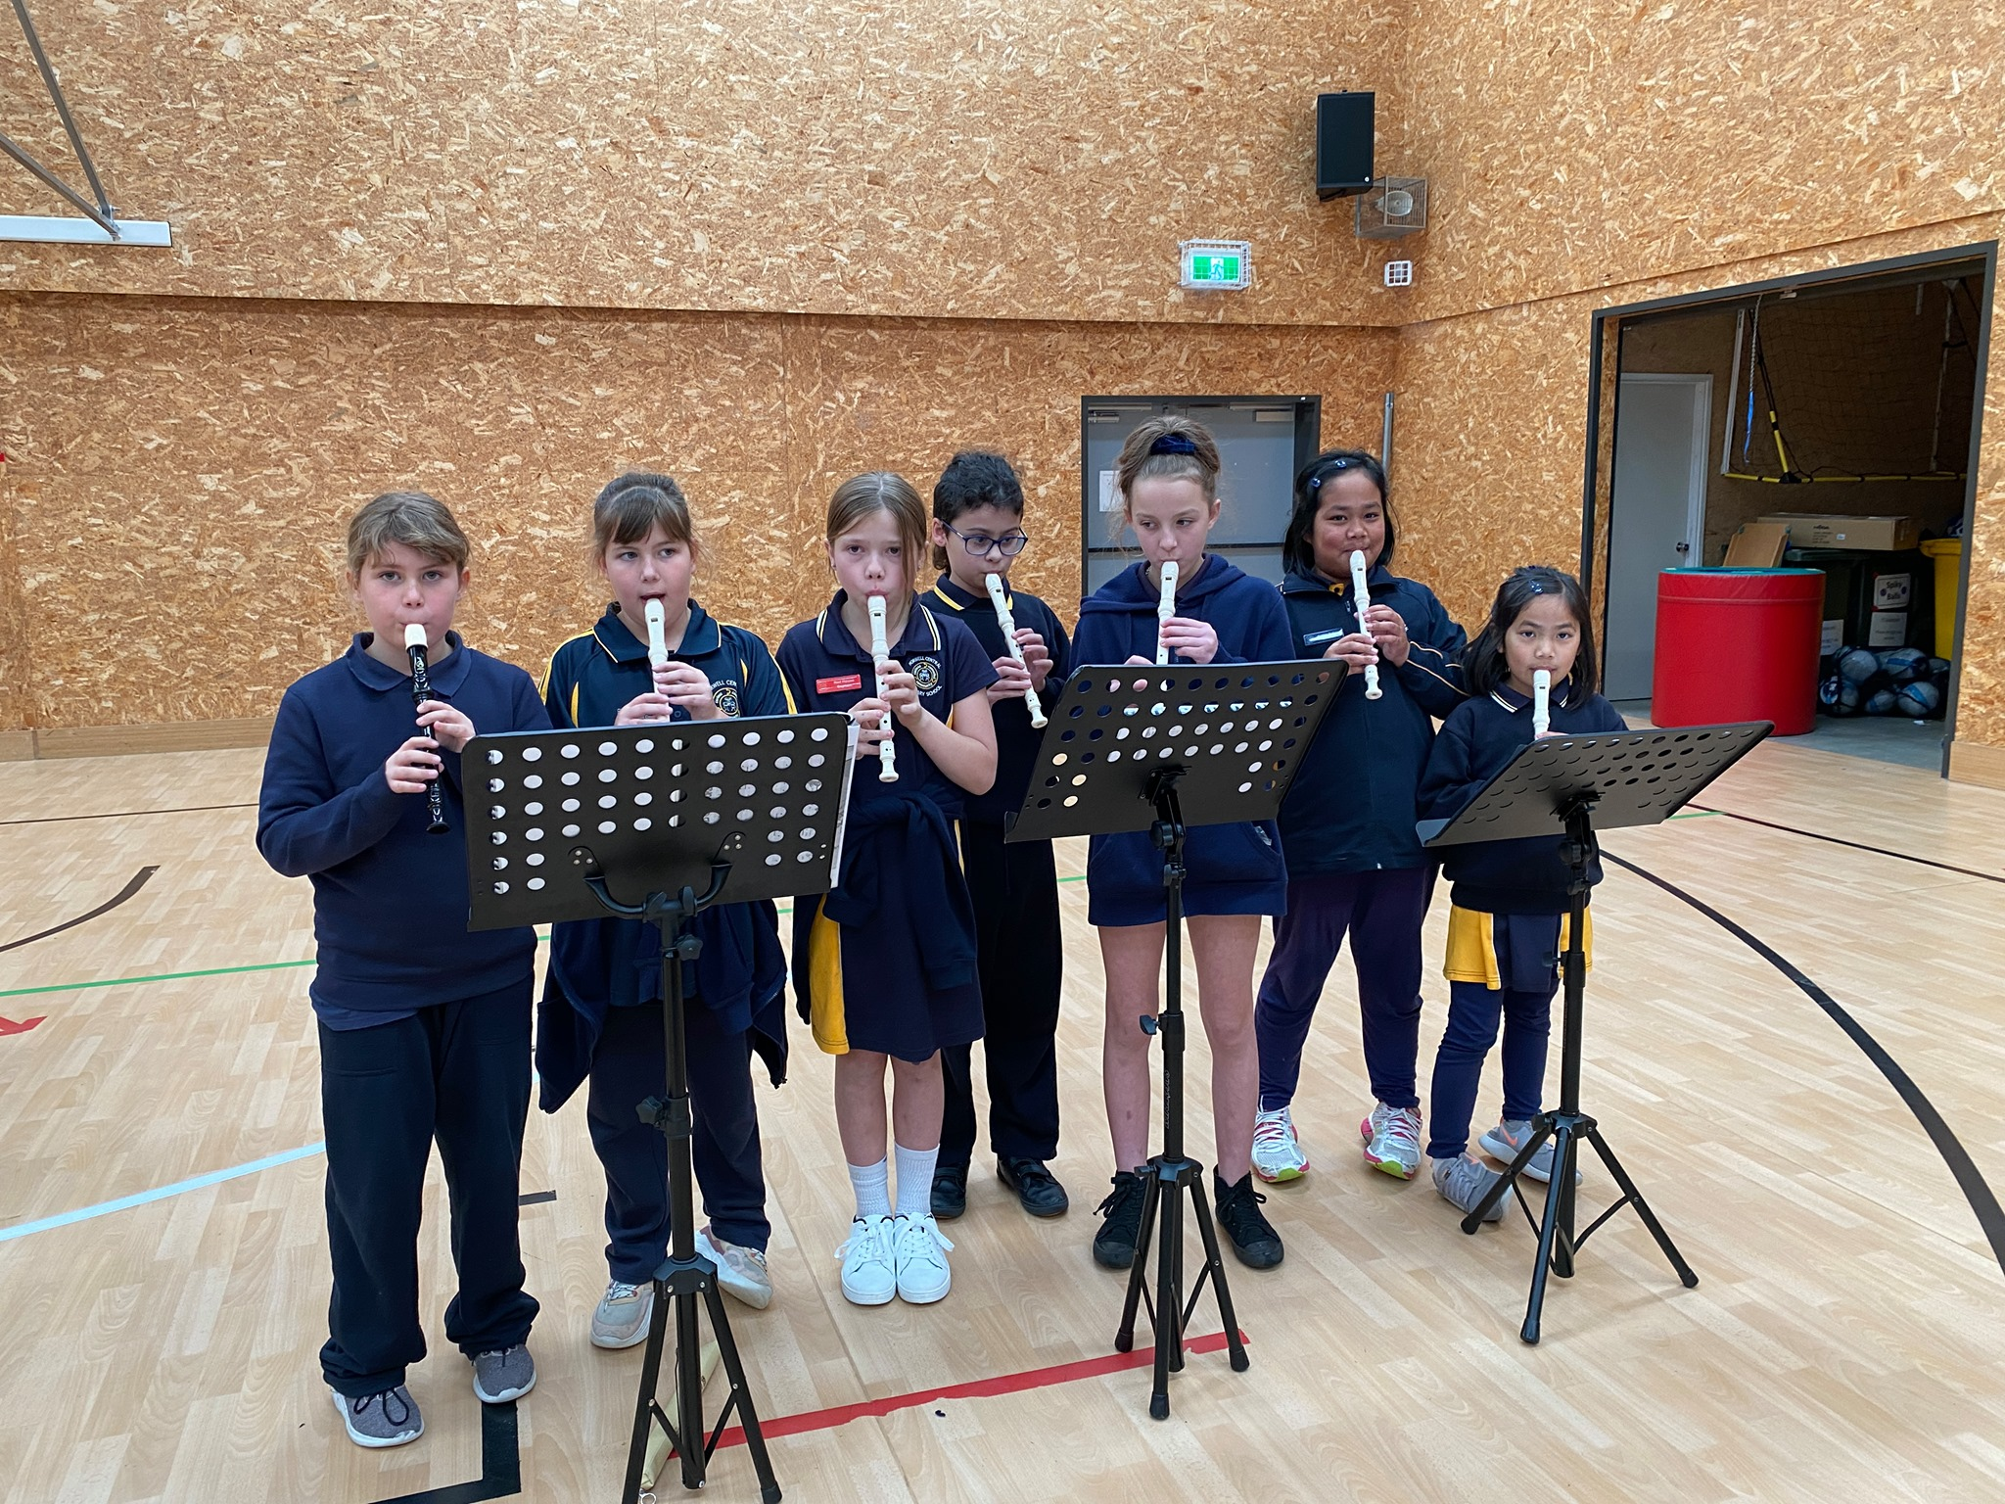

Teaching and Learning
At Morwell Central Primary School, our staff are committed to ensuring high quality, evidence-informed teaching and learning practices.
Our approach to teaching literacy includes all elements of ‘The Big 6’ of Reading: phonemic awareness, phonics, vocabulary, fluency, comprehension and oral language development. We believe strongly in laying the foundations for reading early, with targeted phonemic lessons for all student and phonics groups that are tailored to each student’s needs, while following a systematic, synthetic phonics program. Rich literature is also incorporated into our approach to teaching literacy with students and teachers reading mentor texts that are then used to inspire reading and writing in the classroom.
Mathematics lessons are sequenced, following team planners, to ensure consistency amongst classes. A balance of explicit instruction and targeted practice is supported with the use of concrete materials and problem-solving.
We are fortunate that all student have targeted learning in The Arts, Health and Physical Education and Digital Technologies, delivered by Specialist Teachers.
Latrobe Valley Eisteddfod
Each year under the direction of our music teacher, students in the Lunchtime Recorder Group perform in the instrumental section at the Latrobe Valley Eisteddfod. This gives students exposure to performing on stage, in front of a large audience.
School Performances
All students in the Senior Learning Hub participate in an annual school musical, performed at the end of Term 3.
Students in the Prep-2 Learning Hubs, and 3-4 Hub are involved in a school concert in Term 4. These are performed in our state of the art Performing Arts Centre.
Library
Children are encouraged to borrow books regularly from our Library. All home groups have an allocated weekly library session with their teacher, where they can borrow books.

Slide 4

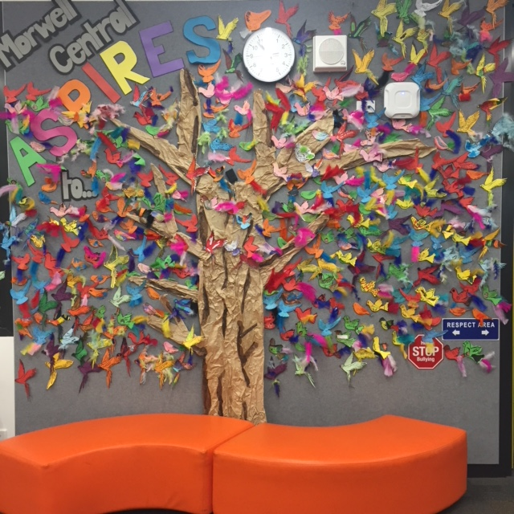
Ready to Learn
Morwell Central Primary School has implemented the Berry St Educational Model
(BSEM) across the school which is designed to meet the educational needs of all
students.
At Morwell Central Primary School, a strong emphasis is placed on:
Building relationships and understanding how to improve student engagement, wellbeing, and academic success, helping every learner thrive.
Helping students to be ‘Ready to Learn’ to be successful.
Underpinning all behaviours within the school using the core ASPIRE values of Acceptance, Support, Persistence, Individual Responsibility, Respect and Excellence.
Teaching and developing social skills through the explicit instruction of ASPIRE Values lessons and self-regulation strategies and techniques.
The development of My Job, Your Job, Our Job behaviourial expectations - Teachers and students develop classroom behaviours and expectations around what the teachers’ and students’ jobs are.
Developing independent learners, who are able to regulate their behaviour.
All teachers deliver teaching and learning opportunities with the Berry Street Model embedded and include explicit lessons on our ASPIRE values and Ready to Learn techniques and strategies.
Rethink and Reflect
Morwell Central Primary School implements a program called Rethink and Reflect to teach and reinforce social skills, and forms the foundations of our student behaviour change process. The program aims to improve the social functioning of all children.
The Rethink and Reflect program focuses on teaching children good communication, problem solving and behavioural skills. It encourages students to rethink and reflect about their responses in certain situations and encourages them to think about choices and natural consequences.

Slide 5
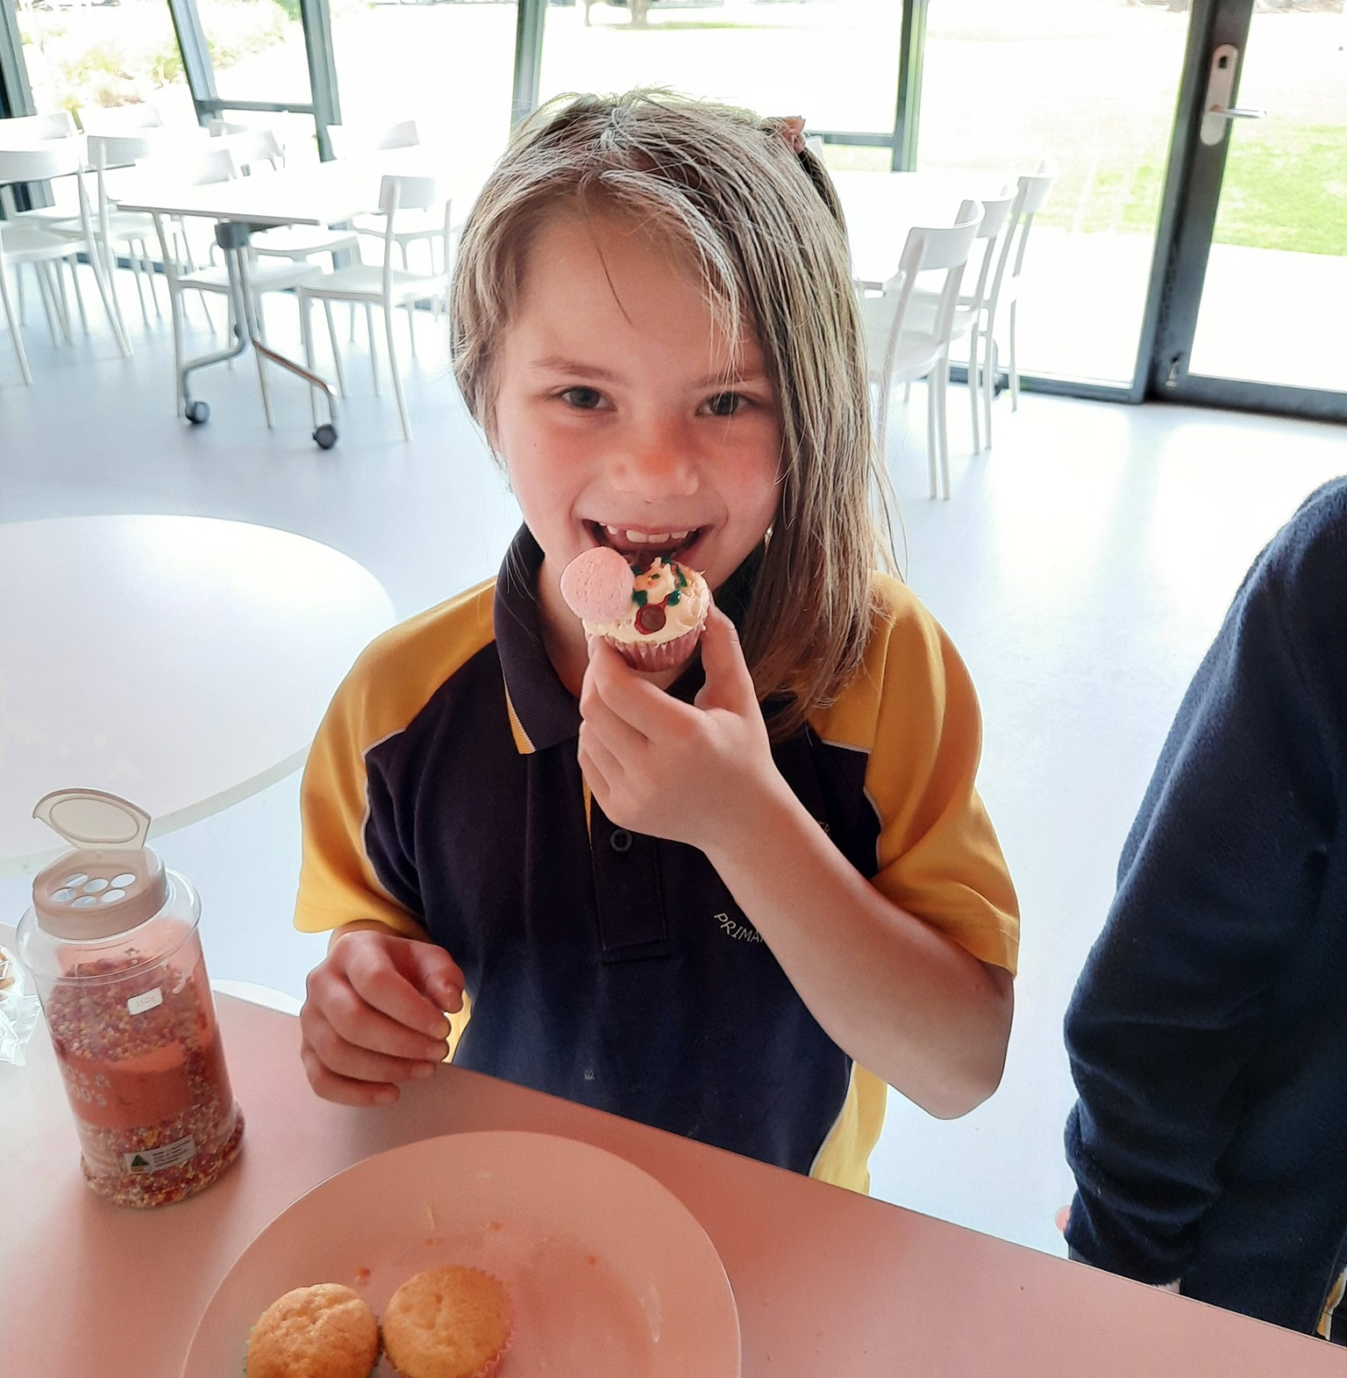






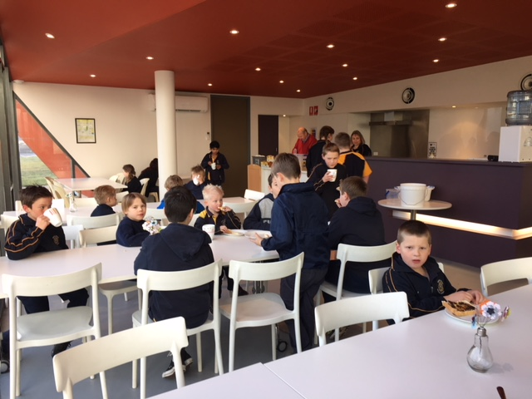

Student Wellbeing
ASPIRE Values
At Morwell Central Primary School we believe everyone has the right to fully participate in an educational environment that is safe, supportive and inclusive. Underpinning all behaviours within the school are the core ASPIRE values of Acceptance, Support, Persistence, Individual Responsibility, Respect and Excellence.
Each week students are rewarded for their outstanding demonstration of our ASPIRE values.
ASPIRE Tickets and Market
Students making good choices will be given ASPIRE positive behaviour tickets and Golden Tickets, which can be redeemed for activities or items of their choice from a student-compiled ASPIRE catalogue.
Each week student leaders collect and tally the ASPIRE and Golden Tickets that each student has earned and once a week students have the opportunity to spend their tickets at the ASPIRE Market.
Wellbeing Team
The school has an extensive Wellbeing Team who provide various supports to students and their families.
My Job, Your Job, Our Job
Breakfast Club is open in The PAC from 7:50am every day. Students can enjoy cereal, toast with a choice of spreads, and milk or milo. Extra items can include banana bread, muffins, pancakes, raisin toast or sausages.
Teachers and students develop classroom behaviours and expectations based on collaborative discussions around what the teachers and students' jobs are. This type of collaborative discussion ensures everyone is responsible for their own behaviour and choices.
Breakfast Club
Our Place is an initiative of the Colman Education Foundation and is located on the Morwell Central site. Through the Foundation’s ten-year partnership with the Victorian state government, Our Place has been implemented in ten school sites across Victoria, with the support of philanthropic partners.
It provides support and activities for parents and children of all ages. Check out their website for more information.

Slide 6

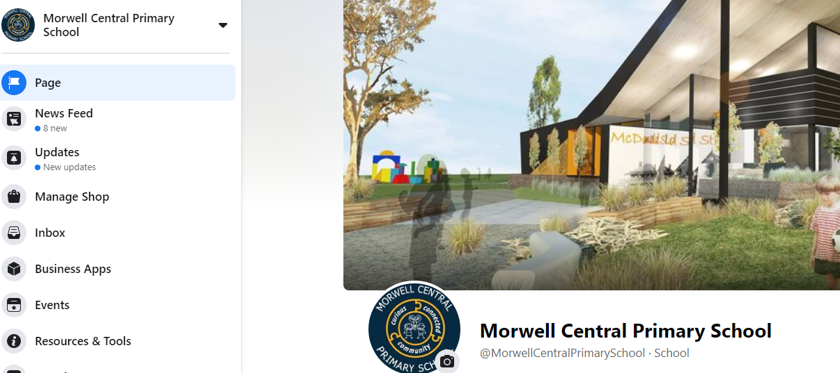

Parent Information
Communication Platforms
Facebook​
Morwell Central has its own Facebook page that is regularly updated with news, events and photos. Our administration team work hard to keep our parents/carers and community up to date with the latest information and activities occurring across the school.
You can also use this platform to communicate with the school via the private messenger function.
Compass is the school’s online application that allows direct communication between the school, parents and students.
When we post a note or a communication on Facebook we also upload it to Compass. This allows parents to access important information if they do not use Facebook .
Automated smart phone notifications and emails are sent out to parents informing them whenever a new notification is released.

Slide 7
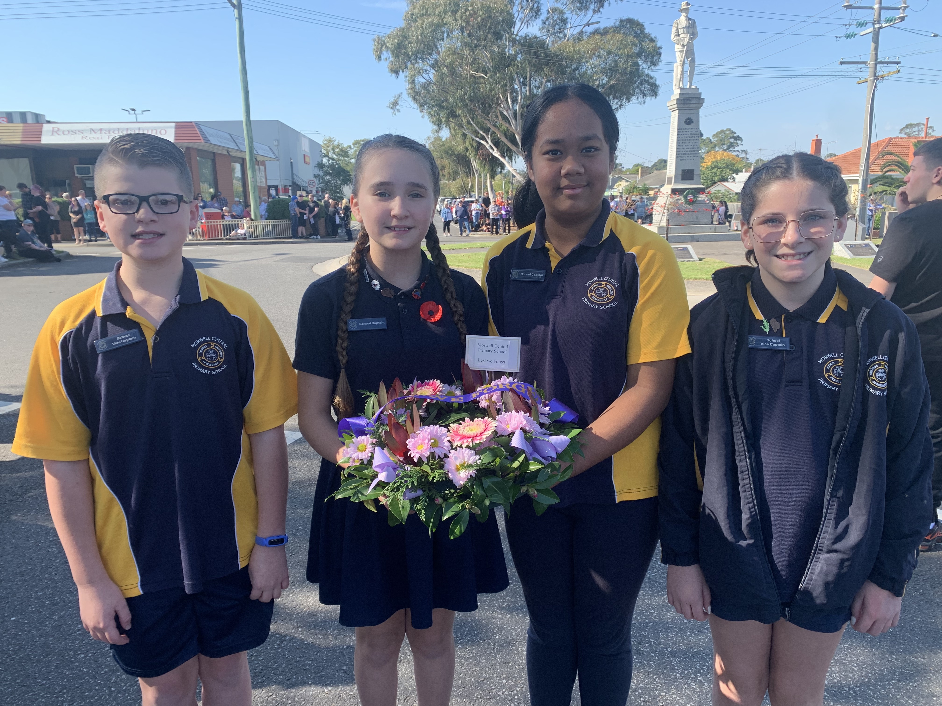

Student
Paste text here…
Leadership
Leadership Program
At Morwell Central Primary School we believe that every child has the potential to be a leader given the right set of circumstances and environment. Each year we run a Young Leaders’ Program for our Grade 4 and 5 students to help all individuals reach their full leadership potential and instill a culture of leadership within the school.
The Young Leaders’ Program:
Develops confidence, character and citizenship in young people.
Promotes both personal and public leadership.
Is based on the building blocks of presentation skills, responsibility, organization and teamwork.
Leadership Roles
Students have the opportunity to represent their peers as School Captains, Vice Captains, House Captains and House Vice Captains, Home group Representatives, Junior School Councillors and Transition Leaders.
Junior School Council
Morwell Central Primary School offers students in Years 3-6 the opportunity to be active members of our school community.
Junior School Councillors are tasked with being the voice of our student cohort and organising fun events for our school.
The JSC are also responsible for many fundraising initiatives and creative ideas within our school.

Slide 8

General Information
Assembly
Every second week, all classes attend Friday afternoon Assembly in the gym at 2.30pm. Our School Captains lead Assembly, and classroom teachers provide awards. Parent attendance is encouraged. Gates are opened at 2.20pm.
Bike Shed
Students riding bikes or scooters to school are to put them in the bike shed before school. This shed is locked after the first bell in the morning and will be unlocked in the afternoon.
Students need to wear the appropriate safety gear.
No bikes or scooters are to be ridden in the school grounds.
Mobile Phones and Devices
Mobile phones are not permitted by students during the hours of supervision 8.30am-3.00pm. Phones and devices are to be handed in at the office at the start of the day where they are stored securely until they are collected at the end of the day.
Students with Apple watches or similar are to have notifications turned off.
Camps
Every second year our students in
Grades 3 – 6 take part in our camp program.
Parents are notified well in advance of the dates and costs. Every effort is made to keep costs down to a minimum to ensure all children can take part.
Excursions
Throughout the year all students have opportunities to attend special programs in the form of excursions. Costs are kept to a minimum and the number of these special programs is restricted.

Slide 9
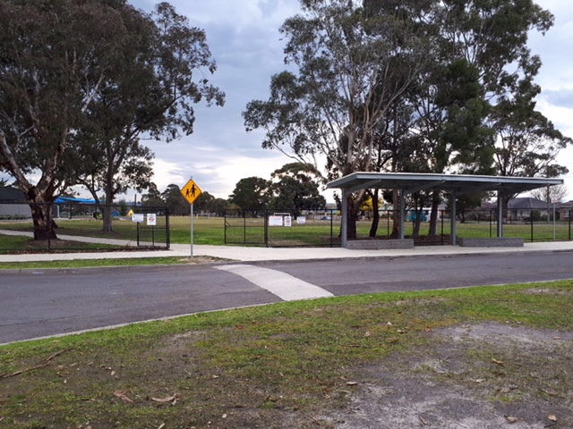
General Information
Late Arrival
Any students that arrive late are to come through the office area and be signed in by our office staff. Students will be given a card, which needs to be handed to their homeroom teacher. Students who are late miss out on our daily ”Ready To Learn” time activities which has the potential to impact negatively on their day at school. Being present for the start of each day is extremely important to ensure that students are set up to be successful whilst at school. If a child is regularly late, the school will seek to identify ways to support.
Voluntary Financial Contributions
School financial contributions are voluntary. All students are provided free instruction to fulfil the standard Victorian Curriculum.
Nevertheless, School Council advises an amount each year to support programs outside the traditional structure.
Payment is voluntary, and we thank you for your support.
Signing In and Out
Camps, Sport and Excursion Funds (CSEF)
Parents are asked to come through the office and complete the information on the Compass Kiosk if children are leaving school before 3:00pm. Parents also need to sign children out if they have appointments during school hours. If students are returned to school after an appointment, they must be signed back in through office staff.
The Camps, Sport and Excursion Funds (CSEF) is provided by the Government to help meet the educational needs of your children. To be eligible for CSEF, families must have a current Health Care Card. Full details are available from the office.
Absences
Payments to the School
The Education Department requires parents to supply the school with a written explanation for the absence of any child.
If your child is absent due to illness or any other reason, please contact the office after 8:15am so that we know why your child is not at school. If verbal or written notification of an absence is not provided, our office staff will make contact the same day to check as to why your child is not at school. Absences can be logged on Compass by following the step-by-step guides that will be sent home. If you require support, please phone the school and a member of the office staff will help you.
The school accepts bank transfer or cash for payments. All money sent to the school should be enclosed in a sealed envelope, marked with your child’s name, homeroom, the amount enclosed and what it is for. Please note that no money is kept at school for change.
Pick up, Drop Off & Gates
At Morwell Central Primary School we care for the safety and wellbeing of all our students. Students can enter the school through four entry points located on McDonald Street, Hoyle Street, Holmes Road and our Pick-up/Drop off lane at the corner of McDonald and Holmes Road. Given the nature of the Drop-Off/Pick-Up zone, NO PARKING is allowed in this area. This area is supervised by staff before and after school. Cars can ONLY enter this area from the entrance on McDonald Street and is one-way only. Drop-Off/Pick-Up is not accessible for pedestrians or students on bikes or scooters. Very busy streets surround our school, and it is essential that parents observe the parking restrictions when dropping off children at any gate. There is no parking on the grass beside the Drop-Off/Pick-Up area.

Slide 10

Health and Safety
Injury
Infectious Diseases
The Ministry of Education requires the following Exclusion Table to be observed in cases of infectious diseases. Please note that for children who have not been inoculated prior to coming to school, the exclusion time is much longer.
The school has trained First Aid staff who attend to minor injuries and record these via the Compass portal.A message is sent via Compass explaining the injury and treatment given.
In the event of a serious injury or sickness at school, parents will be contacted immediately, or if unavailable, the emergency person listed on the child’s file will be contacted. In the case of an emergency an ambulance will be called immediately. Parents will be notified as soon as possible.
Disease | Policy
Chicken Pox | Student excluded until fully recovered – Blistered fully dried or for at least 5 days after eruption first appears.
Mumps | Exclude for 9 days or until swelling goes down.
Measles, Rubella | Exclude for at least 4 days from onset of rash.
Impetigo (School sores) | Exclude until appropriate treatment has begun. Sores must be covered with a watertight dressing.
Conjunctivitis | Exclude until discharge from the eyes has ceased.
Emergency Information
When you enrol your child, you provide us with certain information concerning them. If there is any change in the information that you have provided, please contact the school immediately to ensure that this information is updated. Note that information provided is confidential and is only used for the care of your child and will not be made available to anyone outside the Department of Education.
Headlice
From time to time there will be outbreaks of head lice throughout the school. Parental consent for head checks is given when enrolment forms are signed prior to commencement at Morwell Central. If your child is found to have headlice you will be notified about the need to keep your child home until treatment has occurred. Your child must be treated before they can return to school. If you suspect that your child has headlice please notify the school immediately.
School Nurse
Our school nurse works onsite five days a week.
Please call the office if you would like to talk with her.
Medication
The school is keen to look after the total wellbeing of its students and acknowledges that medication may be essential for some students. All medication for students is kept at the office and must be signed in by a parent. Written instructions on how and when to administer the medication must be provided.
Students who suffer from asthma must have an Asthma Plan completed and filed at the office. This should be updated regularly.
It is important that the school is informed of any ongoing illness or medical problems your child may have. Appropriate plans for managing these should be discussed with school staff at the start of the school year.

Slide 11
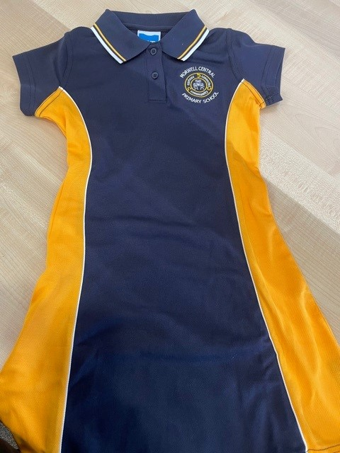
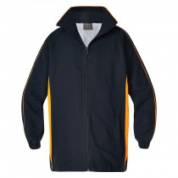
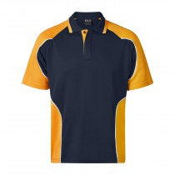
Uniforms
Uniforms are to be worn every day unless a uniform free day is specified. School policy also states that children must be in school uniform to participate in excursions outside of the school.
Children are expected to wear the school uniform which consists of a mix and match combination of navy pants, either our paneled yellow and navy polo or plain navy polo, and jackets. Uniforms with the school logo can be ordered from the school’s uniform shop. Plain navy clothes can be purchased from Big W, K Mart or other outlets.
Reporting
Teachers generate student academic reports on Compass, including end of semester and progress reports. Parents can easily and regularly view their child's reports through the Compass system.
Attendance
Student attendance can be recorded online, allowing for a much more reliable and up-to-date source of information for the school and parent. Parents can also issue sick and absent notes via the system, both in advance and for previous absent days. The School will be notified instantly, and the student's attendance will reflect this.
Girls Uniform
Summer Navy and white check school dress
Navy and paneled yellow school dress
Navy jumper or jacket or school jacket Navy shorts or skirts Navy and yellow paneled polo shirt or plain navy polo.
Winter
Navy pants or tracksuit
Navy jumper or jacket or school jacket
Navy and yellow paneled polo shirt or plain navy polo.
Boys Uniform
Summer Navy jumper or jacket or school jacket
Navy shorts Navy and yellow paneled polo shirt or plain navy polo
Winter
Navy pants or tracksuit
Navy jumper or jacket or school jacket
Navy and yellow paneled polo shirt
Lost Property
School clothing and other items should be clearly labelled with your child’s name. Each Learning Hub will have a lost property tub. If your child loses an article of clothing, please check with your child's homeroom teacher. They will check the lost property kept in the Hub admin area for you.
Sun Hats
It is school policy that during Term 1 and Term 4 children must wear a wide brim hat outside. Preps and new students to the school are given a hat when they commence. In Term 2 and Term 3, if UV levels are higher than 3.5 students will be asked to wear their hats. If your child needs a new hat, they are available to purchase at the office for $13.50. Hats should remain in your child’s homeroom and not taken home.

Slide 12
“A Curious, connected learning community”
Morwell Central Primary School
47-87 McDonald Street, Morwell
Phone: 5136 5568
E-mail: morwell.central.ps@education.vic.gov.au
Web: www.morwellcentralps.vic.edu.au
Principal: Mrs Narelle Bloomfield
Business Manager: Mrs Lisa Farley

